Slide 1
Associated Student Government
General Election, Senate
2018
Notes:
Welcome, glad you are here and wanting to be involved.

Slide 2
Meet the Current ASG Leadership Team
President – Andrew Counce
Vice President – Natalie Counce
Secretary – Ashton Yarbrough
Treasurer – Macarena Arce
Chief of Staff – J.T. Hale
Chair of the Senate – Colman Betler
Chief Justice – Andrew Hansen
Freshman Leadership Forum Coordinator – Abigail Walker
Advisor – Michael McAllister
Notes:
All: Introduction - Presenters

Slide 3
What is ASG?
ASG is a student-led organization that acts as an organized voice for all students and strives to effectively represent student interest.
Notes:
What is ASG? Mention our Vision – “To represent the common interests and voice of all students, the Associated Student Government provides an educational experience of shared governance in the University’s decision and policy making process.”

Slide 4
ASG’s Purpose
The Associated Student Government shall act as an organized voice for all students of the University of Arkansas, to effectively represent students in the University’s decision and policy making process and to provide a broad educational experience for students, while promoting citizenship on campus and in the greater community. In doing so, ASG knowingly and responsibly recognizes the students’ roles in the shared governance of the University of Arkansas.
Notes:
Talk about the functionality of ASG’s purpose; programs – Readership, SafeRide, Family Weekend, Recycling with the Razorbacks, etc.; representation – 24 hour library during finals, helped improve sustainability efforts on campus, provide funding to RSOs, helped keep football ticket prices low, etc.

Slide 5
ASG ‘17-’18 Fast Facts
-ASG Membership consists of 255 active student leaders including the 6 Executive Officers, 50 Senators, 50 Graduate Student Congress Representatives, 25 Cabinet Officials, 40 Freshman Leadership Forum, 11 members of Judicial, 9 Office of Financial Affairs Board Members, 7 Freshman Leadership Forum Staff, and nearly 100 University-Wide Committee Appointments
Recent Executive and Legislative Achievements Include: Work It Off Program, Meal Donation Program, Grade Forgiveness Policy Change, Good Samaritan Policy, Legislative Lobbying Trips to D.C. and Little Rock, Ask ASG Day, Institution of Campus Closet, Sidewalk (Senior Walk) Repair Legislation.
ASG hosts nearly two dozen events a year, including: Family of the Year, Health Week, Creed Week, The Chancellor’s Ball, Welcome Back Cookout, Scooter Safety Awareness Day, Homecoming Court Selection, Readership Day, Faculty Appreciation Banquet, MLK Day Vigil, Rollin’ with the Razorbacks, Sexual Assault Awareness Day and many more!
ASG’s budget is half a million dollars and includes funding for Registered Student Organizations, Safe Ride, Razorback Readership, Athletic promotions, programs, events, legislative actions, leadership development, promotion, and much more.
Notes:
What is ASG? Mention our Vision – “To represent the common interests and voice of all students, the Associated Student Government provides an educational experience of shared governance in the University’s decision and policy making process.”

Slide 6
ASG’s Purpose
Shared Governance at the University of Arkansas
New Policy
The University of Arkansas Board of Trustees
Chancellor’s Executive
Committee
Associated Student
Government
THE UNIVERSITY BUREAUCRACY
Faculty Senate
Staff Senate
Students, Faculty, Staff, and Community Members
Notes:
Talk about the functionality of ASG’s purpose; programs – Readership, SafeRide, Family Weekend, Recycling with the Razorbacks, etc.; representation – 24 hour library during finals, helped improve sustainability efforts on campus, provide funding to RSOs, helped keep football ticket prices low, etc.

Slide 7
Organizational Structure
Executive
Executive Committee: President, Vice President, Secretary, Treasurer, the Chair of the Senate, & the Chief of Staff
Cabinet: 25 Appointed Positions
Judicial
9 Justices, and 2 Judicial Proxies
Legislative
50 Senators and Chair of Senate
University Committees
Approximately 100 Individuals Appointed by the ASG VP
Freshman Leadership Forum
40 Freshman Leaders Selected via Application
Flagship Programs
Safe Ride, Razorback Readership, Work It Off, Meal Donation Program, Campus Closet
Hallmark Events
Chancellor’s Ball, Rollin’ with the Razorbacks, Faculty Appreciation Banquet
Notes:
Briefly discuss the structure to provide context for involvement

Slide 8
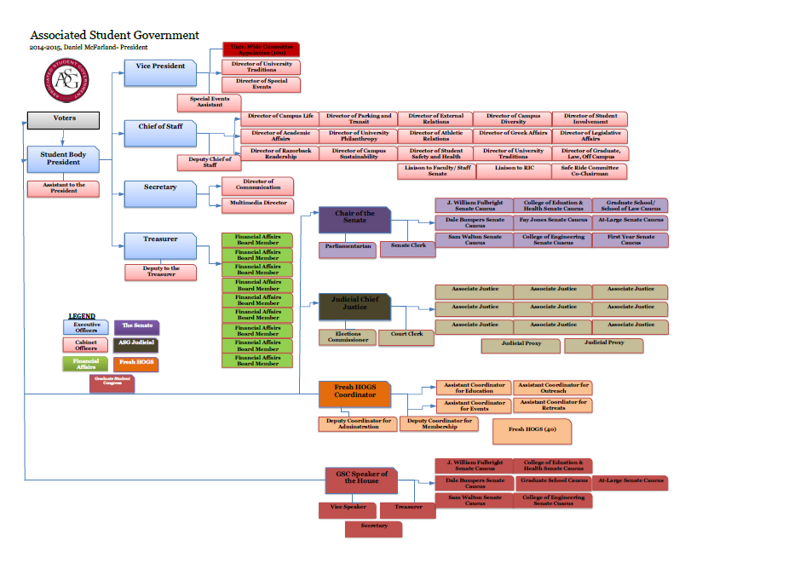
ASG ‘17- ‘18 Organizational Chart
Notes:
What is ASG? Mention our Vision – “To represent the common interests and voice of all students, the Associated Student Government provides an educational experience of shared governance in the University’s decision and policy making process.”

Slide 9
Senate Goals for the Year
Chair of the Senate Goals:
Provide senators with the tools necessary to best serve their constituents;
Increase senate transparency through student accessibility and senator accountability; and
Increase constituent input and execution of senate initiatives.
Increase utilization of ASG advisors to ensure thoughtful legislation is being enacted.
Notes:
Talk about goals for senate; refer to blog and senate website; include examples

Slide 10
Day in the Life of a Senator
Senate Meetings – Tuesday nights 6 pm
Committee Work – Bi-weekly meetings
Serve on at least 1 Senate Standing Committee
Seeking Constituent Input
College Caucuses
Town Hall Meetings
Notes:
Talk about time commitment, role as senator, expectations

Slide 11
Special Senate Offices
Senate Executive Committee
Legislative Clerk, Parliamentarian, & Sergeant at Arms
Committees
Academics, Campus Life, Internal Affairs, Infrastructure
Notes:
Leadership opportunities in senate, talk about each role

Slide 12
How the Elections Work
Any student enrolled in 1 credit hour is eligible to vote
Elections online at via Qualtrics; paper ballots are also available in the OSA Office
Login using e-mail ID (not whole address) and password
Choose college of enrollment
Must choose one college if dual enrolled
Students will have the ability to vote for a block equal to the number of seats available
For example, WCOB students can vote for up to 8 senators
Online Candidate Database
Application Question, Biographies, & Pictures
Notes:
Discuss elections in general

Slide 13
Senate Seats
Senate Seats – 50

Slide 14
Election Specifics
Dates
Applications are due Wednesday, February 14th, at 4pm(CT).
Campaigning begins 12am (CT) February 26th or as soon as notified by the Chief Justice.
Voting runs from 9am (CT) Monday, March 5th through 4pm (CT) Wednesday, March 7th
Election Policies
See Elections Packet
Violations
See Elections Packet
Notes:
Work through elections packet, highlighted sections

Slide 15
Election Policies/Violations
You must turn in an expenditure report, even if you do not spend any money on the election.
Understand that if you do not submit the expenditure report, your seat and victory will be vacated if you are elected.
You application will not be processed until you attend the in-person candidate orientation OR pass the online quiz pertaining to election information and guidelines
You do not need to take the quiz and attend the orientation, only one is required. Completing the online quiz is recommended.

Slide 16
Election Policies/Violations
Please pay close attention to the regulations regarding elections in the ASG Constitution and Code outlines in the Elections Packet.
Many important rules can be found in Title V Section 1 of the ASG Code. (this is outlined in the elections packet)
By passing the online quiz or attending the candidate orientation session, you agree that you will be held responsible for any elections violations and that you are aware of the regulations.

Slide 17
How to Run a Successful Senate Campaign
Planning
Platform
Fundraising & Budgeting
Scheduling
Visibility
Physical
Online
Outreach
Meet & Greet
Organizations
E-Mail Lists

Slide 18
What to Expect Next
Senate Meetings
Every Tuesdays at 6:00 pm
Serve on a Senate Committee
Participate in your College Caucus
Confirm Judicial Appointments
Vote on OFA Standing Rules
Write, debate, and vote on legislation
Notes:
A full schedule will be provided by the head of your respective houses.

Slide 19
Questions?

