Slide 1
2020-2021 General Election Senate Candidate Orientation Session

Slide 2
Candidate Orientation Topics
Election Timeline
Campaigning
Rules & Regulations
Election
Complaints
Expenditure Reports
Results

Slide 3
Election Timeline
Executive and Senate Candidate Application: opens Jan. 27th at 9 a.m., closes Feb. 3rd at NOON
Optional Senate Candidate Orientation: Jan. 29th at 5:30 p.m., ARKU 403*
Senate Candidate Orientation Quiz: Due Feb. 3rd at NOON
Mandatory Executive Candidate Orientation: Feb. 12th at 5:30 p.m., ARKU 403
Executive Candidate Soft Campaigning begins Feb. 19th at 4 p.m.
Secretary/Treasurer Debate: Feb. 25th , 6:30 p.m., Giffels Auditorium
President/Vice President Debate: Feb. 26th , 6:30 p.m., Giffels Auditorium
Town Hall Debate: Feb. 27th, 6:30 p.m., Giffels Auditorium

Slide 4
Election Timeline
Senate Candidate Soft Campaigning begins Feb. 27th at 6 p.m. or upon notification from the Chief Justice
Executive Candidate & Senate Candidate Hard Campaigning begins at 12:01 a.m. on March 2nd
Elections Cookout: March 2nd, 11 a.m.-2 p.m.
Election: March 2nd-4th
Voting opens at 9 a.m. on the 2nd
Voting closes at 4 p.m. on the 4th (All campaigning ends)
Senate and Executive Elections Expenditure Report Deadline: March 5th at NOON

Slide 5
Role of Senate: Duties & Expectations
Represent the voice of the student body
Propose bills and resolutions to solve issues on campus or support campus improvements
Serve on senate committees focused on specific issues
Attend weekly senate meetings, every Tuesday at 6 p.m.
Meet with fellow senators outside of senate as needed to collaborate on legislation
Communicate with administrators, faculty, and staff about legislation ideas and campus issues
Support fellow ASG branches by attending ASG and partner events, tabling, and volunteering

Slide 6
Campaigning
“Soft” campaigning is allowed to begin on Thursday, February 28th, 2019 at 6:00 p.m. or upon notification from the Chief Justice. You may spread the word of your candidacy for Senate at this time and garner support from the campus community via word of mouth, social media, and digital outlets.
No physical materials may be distributed during soft campaigning (e.g., banners, posters, yard signs, chalking, handouts)
ASGJ mandates that candidates will refrain from distributing or placing materials, of any kind, until March 4th, 2019 at 12:01 AM CT. At this time, all approved methods of campaigning will be permitted.

Slide 7
Voting & the Ballot
All Students enrolled in at least one (1) credit hour at the University of Arkansas are eligible to vote.
Write in candidates will not be accepted.
The order of Candidates on the ballot shall appear in randomized order by last name.

Slide 8
Rules & Regulations
All candidates must follow rules outlined in the Elections Packet and ASG Code & Constitution, especially Article VI, Section 2 of the ASG Constitution and Title VII, Sections 1, 2, 5, 7, 8, 9, 10 of the ASG Code
Take time to familiarize yourself with the Elections Packet and go over ASG's policies on Elections

Slide 9
Rules & Regulations
Campaigning shall be defined as an attempt to influence the decision or opinion of a voter in regard to the election.
All candidates must complete the registration process.
During the official time when the election is being conducted, no campaigning shall occur within twenty-five (25) feet of any computer lab on campus, including the general access labs, any departmental labs, or any labs in residence halls, or Greek living units. Additionally, campaigning shall not occur within fifty (50) feet of the official ASG sponsored polling stations. Polling station locations shall be announced no later than the candidate orientation session. The twenty-five (25) feet rule shall only apply to computer labs on the same building floor or level that the candidate is campaigning on; it does not apply to the vertical plane
Candidates and any member of campaign staffs are prohibited from setting up computers or laptops for the purpose of establishing a polling station. A polling station shall be defined as areas any computer that accesses the University network for the purpose of casting a vote and/or submitting a ballot.
ASG Judicial reserves the right to establish and operate an on-campus polling station.

Slide 10
Rules & Regulations
A voter cannot be asked or required to cast a vote for a candidate in exchange for any service or item of value.
No candidate or campaign staffer shall interfere with the campaigning or with the campaign materials of an opponent.
Campaigning via the use of mass, unsolicited emails on the university networks is strictly prohibited. Candidates must adhere to the Code of Computing Practices at all times.
Candidates cannot use their student print quota to print campaign materials.
Candidates and campaigns must follow all University policies and guidelines for posting and flyer distributing, including any policies or guidelines that may exist within individual buildings and/or areas of campus.

Slide 11
Rules & Regulations
All campaign materials must be removed within twenty-four (24) hours of the conclusion of the election. Failure to do so may result in a fine as deemed appropriate by ASGJ.
Candidates are responsible for any litter that is created due to campaign activities.
Candidates must follow all University procedures concerning use of buildings and sidewalks for campaigning.
Use of campaign stickers is strictly prohibited.
Candidates may not exceed $310 on their campaign for Senate. All candidates must submit an expenditure report form, an itemized budget and receipts/documentation for all of your expenses. The deadline to submit expenditure reports is 12:00 pm NOON (CT) on Thursday, March 5th, 2020. Reports can be turned in to the Office of Student Activities, ARKU A665 or online via HogSync in the ASG Portal.
A report is required even if you do not spend any money on your campaign.
Failure to submit an Expense Report will result in disqualification from the General Election.

Slide 12
The Election
Administered by the Office of Student Activities via Qualtrics
Ballot is accessible at asg.uark.edu/elections
Paper ballots may be submitted, and can be obtained in the Office of Student Activities in ARKU 665 between 8 a.m. and 5 p.m. on the days when voting takes place

Slide 13
Elections Complaints
Complaints and reports of campaign violations must be filed within 24 hours of discovering any alleged violation
Complaints are filed in the Office of Student Activities between the hours of 8 a.m. and 5 p.m.
Campaign Violation Forms can be found attached to the Elections Packet and in the Office of Student Activities
In the event a violation is filed, Title VII, Sections 8, 9, and 10 of the ASG Code will be enacted as far as investigating the violation and determining proper sanctions (if any)
Sanctions could include but are not limited to loss of campaigning privileges, loss of votes, or disqualification
*please see the Elections Packet for a full explanation of the complaint process

Slide 14
Expenditure Reports
Every candidate must submit an expenditure report, whether or not you spend any money on your campaign
Failure to submit an expenditure report will result in disqualification from the election
The spending limit (per candidate) for the 2020-2021 General Election for Senate Candidates is $310
Expenditure Reports provide information on your Income, your Expenses, and any Estimated Costs associated with your campaign.

Slide 15
Expenditure Reports: Deadlines and Submission Types
The Deadline:
March 5th, 2020 at 12:00 pm NOON (CT)
Two Submission Options:
Turn in a physical form with an itemized budget, and receipts/documentation for all of your expenses to the Office of Student Activities (this includes documentation of "Sponsors/Donations" under Income and of items or services listed under Estimated Costs) *this will be explained in a second
Submit your expenditure report form online via HogSync in the ASG Portal. All receipts and documentation will be submitted within this form in a single file for each type of documentation.
Link to submit on HogSync: https://hogsync.uark.edu/submitter/form/start/381994
The physical form and online form will have the exact same information on them.

Slide 16
Expenditure Reports: Guidelines on Form
All boxes with a $ must be filled out with a numerical amount. If you have a box that lists a type of income, expense, or estimated cost that does not apply to the expenditures of your campaign, please write “$0” in the box. If you did not spend any money or receive any donated money or items for your campaign, please list “$0” in every box. Your expenditure report will be considered incomplete if any boxes are left blank, which will result in your disqualification from the election.
NOTE: Just write "0.00" in the box instead of $0 for online
Remember: Total Expenses + Total Estimated Costs MUST=Total Income

Slide 17
Expenditure Reports: Guidelines on Form
Under Income in “Sponsors/Donations” documentation from sponsors and donors must be provided. Documentation is defined as a note/letter, copy/screenshot of an email or text from the sponsor or donor expressing that they have given money to your campaign. If no documentation is provided, your expenditure report will be considered incomplete, which will result in your disqualification from the election.

Slide 18
Expenditure Reports: Guidelines on Form
All items listed in Expenses must have receipts turned in with them. Any report that lists an item in Expenses but does not provide a receipt as proof of purchase for that item will be considered incomplete, and will result in your disqualification from the election. The only exception to this rule is if an item or service is purchased through a transaction that does not generate a receipt. If you purchased an item through a transaction that did not generate a receipt, please provide alternative documentation (such as a note/letter, copy/screenshot of an email or text from the individual that the item was purchased from).

Slide 19
Expenditure Reports: Guidelines on Form
All items listed under Estimated Costs must have documentation either from yourself or the individual who donated a service or item to your campaign. Documentation is defined as a note/letter, copy or screenshot of an email or text from yourself or the individual who donated a service or item to your campaign, expressing that they have given this item or service to your campaign. If no documentation is provided, your expenditure report will be considered incomplete, which will result in your disqualification from the election.

Slide 20
Expenditure Reports: Definition of Incomplete
Most disqualifications occur because an expenditure report is incomplete, not because people forget to turn a report in
What does it mean to be "incomplete"?
Report has a box in a table without a numerical value in it
Money is listed under "Sponsors/Donations" under Income, but provides no documentation
Money is listed under Expenses, but provides no documentation or proof of purchase
Item or service is listed under Estimated Costs, but provides no documentation that this item or service was donated OR there is no estimated cost given for an item or service

Slide 21
Expenditure Reports: Income Table
Income: (This is where you list the sources of the money you spent on your campaign)
Sponsors/Donations (This is not an estimated cost, please list the exact monetary amount that was donated to your campaign.) | $
Personal contributions | $
Estimated Costs (Please see Estimated Costs table below-whatever is listed under “Total Estimated Costs” should be listed here”) | $
Total Income (Cannot exceed $310): | $

Slide 22
Expenditure Reports: Income Table
What should be listed in Income?
For "Sponsors/Donations": Any money that an individual or an organization gives to you that is for your campaign. This could be money given to you for the purpose of purchasing something specific, or it could be money given to spend on your campaign in general.
For "Personal contributions": Money you donate to your campaign
For "Estimated Costs": Whatever you write in the Estimated Costs box in the Income table MUST equal whatever you wrote in the Total Estimated Costs box in the Estimated Costs table
Remember: Total Expenses + Total Estimated Costs MUST = Total Income
Total Income Cannot Exceed $310

Slide 23
Expenditure Reports: Expenses Table
Expenses: (This is where you list how the income for your campaign was spent. You should list any item or service in Expenses that had an exchange of money associated with it.)
Flyers | $
Yard Signs | $
Promotional items (food, beverages, buttons, t-shirts, etc.) | $
Web development | $
Advertisements | $
Misc. | $
Total Expenses: | $

Slide 24
Expenditure Reports: Expenses Table
What should be listed in Expenses?
Any item or service that had an exchange of money associated with it
Every item or service listed in this table MUST have documentation provided
Items or services that are purchased & have a receipt generated should have a RECEIPT submitted as documentation
Items or services that are purchased and DO NOT have a receipt generated should have an alternative form of documentation (What counts?)
What are some examples of purchased items that have no receipts generated for them?
Photos taken by a friend or individual for your campaign
Items purchased by an individual specifically for your campaign, but the individual does not provide you, the candidate, with the receipt
Graphics created by a friend that are paid for by you

Slide 25
Expenditure Reports: Estimated Costs Table
*The following table should only be filled out if you had an item or service donated to your campaign (either by yourself or someone else) and there were no transactions involved for the item or service for the campaign. (Examples: Tents used in campaigns that were owned prior to campaigning, printing done on personal printers and computers, etc.) If you do not have any items or services that require an estimated cost, please list “$0” in each box.
If you have questions about whether or not something should be listed in this table, please contact the ASG Chief Justice at asgjcj@uark.edu prior to the final deadline!
Estimated Costs:
Items Donated by Yourself or Someone Else | $
Services Donated by Yourself or Someone Else | $
Misc. | $
Total Estimated Costs: | $

Slide 26
Expenditure Reports: Estimated Costs Table
Estimated Costs Examples:
Printing flyers from your personal computer on your personal printer with paper and ink that was not purchased specifically for the campaign
Estimating cost for the service of printing
Do you need to list an estimated cost for that computer or printer?
What if you buy paper and ink exclusively for use for your campaign?
What if you had used your friend's computer or printer instead?
Tents used in campaigns that were owned prior to campaigning
Using chalk that you already owned

Slide 27
Expenditure Reports: Example
Scenario: You are running in the 2019-2020 General Election for Senate. You had a budget of $310 to spend on your campaign. To raise support for your campaign, you called your parents and they donated $150 for you to spend. Your RSO donated $50 to your campaign as well. You contributed $20 on top of that.

Slide 28
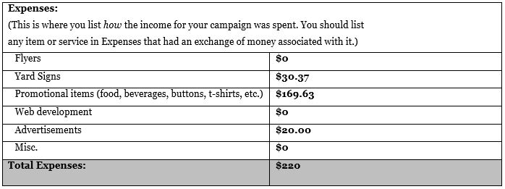
Expenditure Reports: Example
Scenario: For your campaign you ordered 5 yard signs for $30.37. You also bought 15 pizzas for $75. You paid your best friend $20 in cash to take photos of you for your social media graphics. With your remaining money, you decided to buy candy to pass out. All of the candy cost $94.63.

Slide 29
Expenditure Reports: Example
Scenario: After buying that candy, you decided to design flyers to pass out with it. You made the design for free online, and then printed out 135 flyers off of your computer from your printer at home. The night before voting opened, you grabbed some chalk you already had at your house and chalked on campus, campaigning for students to vote for you.
0
0

Slide 30
Expenditure Reports: Questions to Ask
Where did your money come from?
What did you spend that money on?
What materials from your campaign did you use or borrow that will need to have an estimated cost listed with it?
How are you documenting everything from income to expenses, to estimated cost items?
Did every expense have a receipt generated for its purchase?
How are you going to document where your income came from?

Slide 31
Expenditure Reports: Judicial Recommendations
Designate a folder or binder to keep all receipts and documentation in
Draw up an itemized budget as soon as you start collecting money to spend or as soon as you start making purchases
Fill out the itemized budget throughout your campaign-from the time you find out you're on the ballot to the day the polls close
Make sure you account for tax on every purchase to make sure you don't go over the spending limit
When purchasing anything that generates a receipt, do not purchase anything along with it that is not for your campaign
Have someone look over your report before you submit it
There is no such thing as too much documentation

Slide 32
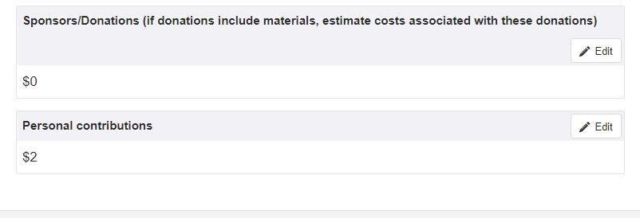
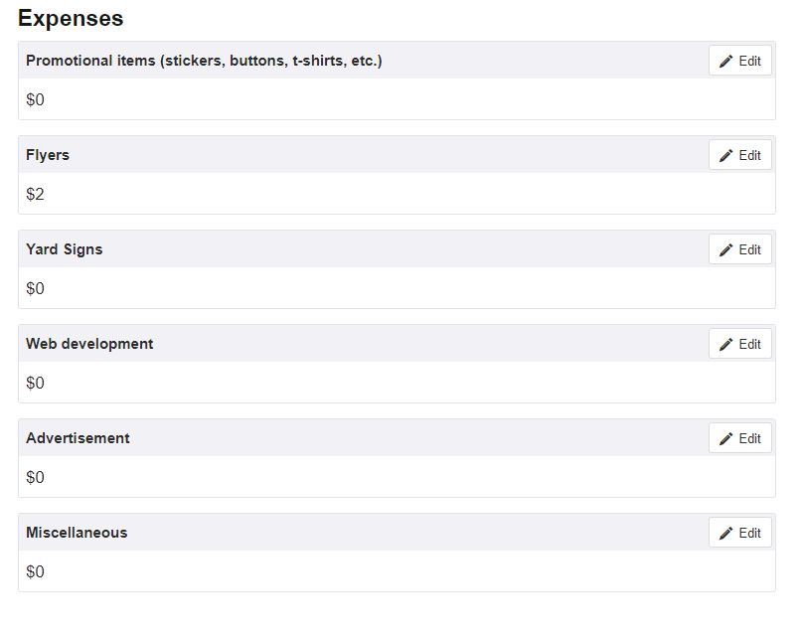

Slide 33
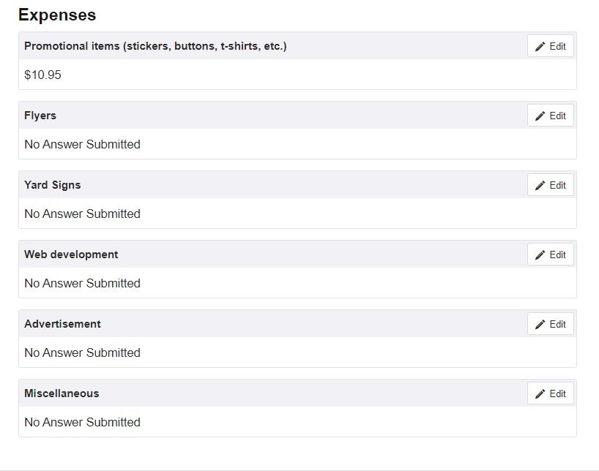

Slide 34
Expenditure Reports: Itemized Budget
An itemized budget must be submitted with your expenditure report. If you did not receive or spend any money, you do not have to submit an itemized budget. If an itemized budget is not submitted, your expenditure report will be considered incomplete, which will result in your disqualification.

Slide 35
Expenditure Reports: Questions
A relative has given an in-kind donation of flyers to you for your campaign. They ordered these flyers from a local company specifically for the campaign, but have misplaced the receipt.
What do you do? How do you document this item?

Slide 36
Expenditure Reports: Questions
A friend has offered to create graphics for your campaign that can be shared on social media. You pay this friend $5.00 in cash.
What do you do? How do you document this item?

Slide 37
Expenditure Reports: Questions
You want to pass promotional items out to students during your campaign, and you need a tent to stand under while you are doing this. Your dad kindly lets you borrow his for its use in your campaign.
What do you do? How do you document this item?

Slide 38
Expenditure Reports: Questions
Your grandma wants to donate money to your campaign. She lives out of state. She wires the money to your personal bank account.
What do you do? How do you document this item?

Slide 39
Results
Once ASGJ has reviewed all expenditure reports and confirmed results, official results will be published on the ASG website and social media

Slide 40
Questions?

